Slide 1
Annual merit allocation process
For Executive Reviewers

Slide 2
Agenda
The following slides:
Review the Executive Reviewer’s Role
Define the SuccessFactors Compensation Module
Define the Merit Allocation process and workflow
Review Merit Planning from the Compensation Manager’s perspective
Review required audits
Review Exports/Reports Available
Review available resources

Slide 3
Learning goals
After this course you will…
Be able to explain the high-level steps and elements of the Annual Merit Allocation process
Be able to identify the key elements of the Executive Reviewer’s role
Have an understanding of the Compensation Manager’s role and process
Be able to identify and access the tools available to assist in the Annual Merit Allocation process

Slide 4
Compensation Module
Defined
The SuccessFactors Compensation Module reduces the manual tracking and uploading of data and spreadsheets during the annual merit allocation process through the use of automated workflows and built-in tools. These features also reduce the time requirement of the Compensation Planning cycle.

Slide 5
Compensation module
Elements
Salary Control
Merit Planning
The first step in the annual Compensation Planning process.
Through a cascade process, budget is allocated to Compensation Managers for the purposes of granting employee merit increases
Cascade path:
Executive Reviewer – President
Executive Reviewers – DFA
Compensation Managers
Salary Control must be finalized before Merit Planning can begin
The annual process of granting merit and equity increases
Increases are based on performance first, with consideration given to the market position and internal equity
The Salary Control process allocates budget for merit increases to each compensation manager
Compensation Managers distribute this budget among individuals
These processes, when combined, are referred to as the Annual Merit Allocation Process

Slide 6
The Executive Reviewer’s Role
Today’s Focus
Overview
Salary Control
(DFA)
Merit Planning
(DFA and Business Manager)
Ensure that the budget for merit increases is distributed appropriately
Distributions should align with the goals of the current year’s merit guidelines
Complete promptly so that Compensation Managers can begin the Merit Planning process
Review data entered by Compensation Managers to ensure compliance to merit guidelines, salary control distributions, performance-based merit allocation
Adjust increases (or request adjustments from Compensation Managers as needed)
Gather executive approval outside of the Compensation system

Slide 7
Salary Control Process
Compensation Administrator
Configure System for Annual Merit
Notify Executive Reviewer - Final of System Readiness
Executive Reviewer - Final
Distribute Budget
Notify Next Level
Executive Reviewer - DFA
Distribute Budget
Cascade to Remaining Levels
Notify Executive Reviewer – Final
 | System Notification
 | Outside System Notification
After all Executive Reviewers – DFA have completed Salary Control, Executive Reviewer – Final’s Level notifies Compensation Administrator

Slide 8
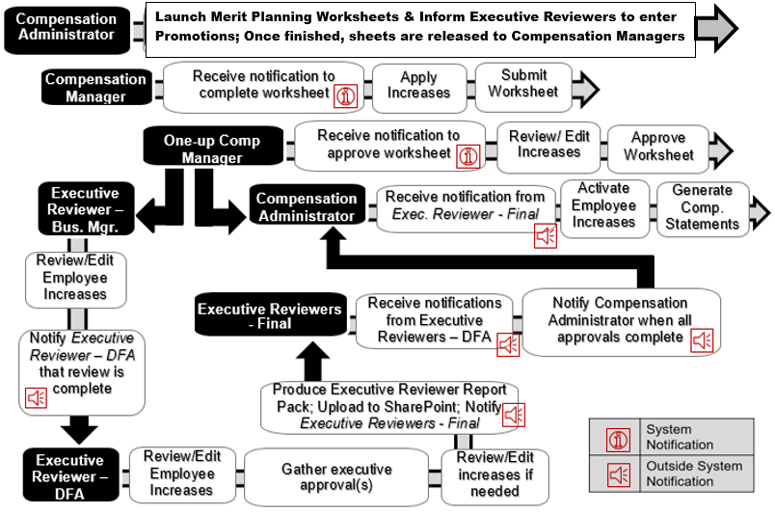
Merit Planning process

Slide 9
Annual merit allocation process
Streamlined View by Role
Role | Configure system | Salary Control | Launch Worksheets | Assign Merit | Approve Merit | Review Unit |  | Final Approval | Publish to System
 |  |  |  |  |  | Dept | Div
Comp Manager |  |  |  | ✓
One-Up Comp Manager |  |  |  |  | ✓
Exec. Reviewer (Bus Mgr) |  |  |  |  |  | ✓
Exec Reviewer (DFA) |  | ✓ |  |  |  |  | ✓
Exec Reviewer (Final) |  | ✓ |  |  |  |  |  | ✓
Comp Admin | ✓ |  | ✓ |  |  |  |  |  | ✓

Slide 10
Merit planning

Slide 11
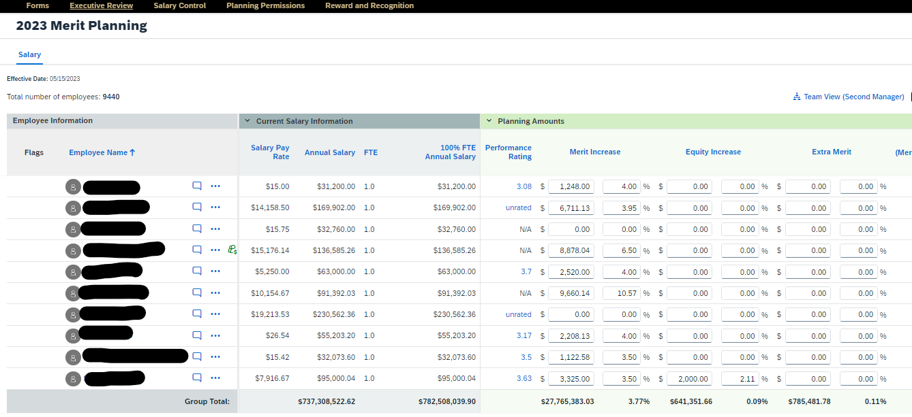
Merit Planning Worksheet
What is it?
The Merit Planning Worksheet lists employees along with their associated employment and compensation information.
Each Compensation Manager’s worksheet consists of only the employees for which they plan compensation.
The worksheet includes numerical entry fields for managers to enter merit and equity increases and administrative adjustments.
Managers submit completed worksheets to be approved by their One-up Compensation Manager.

Slide 12
Merit Planning Worksheet
Key Field Details
When reviewing Current Salary Information, it is important to consider individuals with FTE less than 1.0 and individuals with Academic Year or less than 12- month appointments.
Administrative Adjustment fields can be used to add or change existing Admin Adjustments
Admin Adjustments cannot be removed within the Merit Worksheet. Entering 0 will stop payment but not cancel an existing adjustment wage type.
The Comment field following Administrative Adjustments in the worksheet should be used as outlined by the Merit Policy.
Full field definitions and details are found in the Merit Worksheet Column Additional Information for Compensation Managers.
Field | Draws from Merit Budget
Merit | Y
Equity | Y
Extra Merit | Y
Lump Sum | Y
Administrative Adjustment | N
Promotion | N

Slide 13
Executive Review
Tasks & Tips

Slide 14
Executive Reviewer Responsibilities
Task | Executive Reviewer – Business Manager | Executive Reviewer - DFA
Review data entered by Compensation Managers to ensure compliance with merit guidelines, salary control distributions, and performance-based merit allocation See Required Audits slide for details | ✓ | ✓
After communicating with Compensation Manager, adjust data to ensure compliance with merit guidelines, policies, procedures, and/or budget | ✓ | ✓
Alert the Executive Reviewer – DFA when departmental merit worksheets are ready for division-level review | ✓
Obtain executive approval outside of the Compensation system |  | ✓
Alert the Executive Reviewer – Final when merit data is available in the SharePoint for final review |  | ✓

Slide 15
Executive Reviewer audits
Required Audits
Merit Increases
Equity Increases
Extra Merit
Adherence to Budget
Appropriate Comments for individuals with no merit increase or merit increase greater than 8%
Appropriate comments for new, updated or zeroed Admin Adjustment
Faculty Promotion and merit increase alignment
Staff Promotions entered correctly
Concurrent appointments (check for matching merit increases)
Benefits Premium Threshold
Merit Planning Employee Validation Report located in SuccessFactors lists individuals approaching current benefit threshold
Distribution of merit increase compared to performance
Validate final rate of pay for AY staff and those with a less than 12-month appointment is within the equivalent pay band
Ensure lecturers’ final rate of pay is within assigned lecturer pay band

Slide 16
Reports
Tools to Assist with Audits and Obtaining Approvals
Pre-Merit Planning
Post-Merit Planning
SuccessFactors Report Center
Merit Planning Employee Validation Report
Filter by Compensation Manager
Field Notes:
Position Entry Time
Salary Band Analysis
Benefit Premium Review
Concurrent Flag
Compensation Module
Export Merit Worksheet
Compensation Module
Export Merit Worksheet
Export Detailed and Roll up Reports
Executive Report Pack (DFAs)
Export the Merit Worksheet
Locate template on Merit SharePoint site
Create reports; upload to SharePoint

Slide 17
Complete Compensation Cycle
Final Steps
Once the Executive Reviewer – Business Manager has reviewed/edited all employee merit increases within the system to ensure compliance with the salary policy, he or she will alert the Executive Reviewer – DFA for their area
Once finished with their review, Executive Reviewers – DFA will access the Merit SharePoint site, locate the Executive Reviewer Report Pack template and produce and upload the report.
Executive Reviewers – DFA will alert the Executive Reviewer – Final that the completed merit plan is approved.
The Executive Reviewer – Final will obtain the President’s approval and notify the Compensation Administrator that all merit plans have been approved and are ready to be published in Employee Central.
The Compensation Administrator will activate changes in Employee Central and release the Compensation Statements to be viewable on the employee’s profile.

Slide 18
Resources
Annual Merit Allocation Process
System information: SuccessFactors Compensation Module Training Website
Compensation Managers
Merit Worksheet Column Additional Information for Compensation Managers
Online Course: Merit Planning for Compensation Managers
QRG: Merit Planning for Compensation Managers
QRG: Accessing Compensation Statements for Compensation Manager
Conducting Compensation Conversation Toolkit
One-up Compensation Managers
QRG: Approving Merit Worksheets
Executive Reviewers
Merit Worksheet Column Additional Information
QRG: Update Compensation Manager
Presentation: Annual Merit Allocation Process for Executive Reviewers
Online Course: Executive Reviewer and Merit Planning Training
QRG: Salary Control for Executive Reviewers (DFAs)
Presentation: Salary Control for Executive Reviewers Overview DFA (Video)
QRG: Merit Planning and Promotion Entry for Executive Reviewers
QRG: Importing Merit Increase Data for Executive Reviewers
QRG: Accessing Compensation Statements for Executive Reviewers
Supervisors
QRG: Accessing Compensation Statements for Supervisors

Slide 19
Questions?
Contact: compensation@purdue.edu

